Slide 1

A Professional Development System for Asset Managers

Slide 2
Why the System Works
Who We Are
A professional development organization that:
• Strengthens communications
• Elevates advisor engagement
• Drives measurable behavior change
- not just event-based training
Built by practitioners who led
distribution teams
• Designed for real-world deployment
• Flexible: holistic or modular

Slide 3
Agenda
Overview of The Problem to Be Solved
Solution: The AlphaScale Growth System
  How the Intelligence Works (Under the Hood)
  Why This System Works
How the System Will Work for INSERT FIRM
Details on Each Pillar of the System
Timeline
Appendix (Optional / Deep Dive)

Slide 4
Industry Challenges
For Asset Managers, Three Critical Gaps That Limit Growth . . .
Competency: Inconsistent product fluency and narrative alignment
1
Skills: Wholesalers struggle with consultative conversations and differentiation
2
Measurement: Leaders cannot see who is improving or what is working
3
Most firms attempt to solve these gaps through disconnected training,
tools, and coaching — resulting in activity without durable performance change

Slide 5
The Real Risk Isn’t Activity — It’s Invisible Misalignment
Asset raising and retention opportunities are lost when something goes misunderstood, mispositioned, or misaligned
Client facing team members can be active and still create risk
Firms can’t see:
  Who truly understands products
  Who can apply them correctly
  Where narratives break down
Traditional training and CRM data miss this entirely

Slide 6
Where Positioning Quietly Breaks Down
Without clear signal, positioning risk shows up as:
• Reps defaulting to features instead of portfolio role
• Narratives drifting across teams, tenure, or regions
• Inconsistent framing during volatility or performance pressure
• Leadership reacting after outcomes move

Slide 7
From Activity Data to Judgment Signal
Most systems validate:
• Knowledge
• Activity
• Historical performance
They do not show:
• How product knowledge is applied in real conversations
• Where positioning breaks down under pressure
• When intervention is needed — before outcomes move
Leadership doesn’t need more data. They need judgment-level signal.

Slide 8
Market Opportunity
What High-Performing Asset Managers Systematize
Training tied to outcomes
Consistent messaging across teams & partners
Better advisor engagement
Deeper product fluency
Compliance-friendly data intelligence
AlphaScale exists to make these capabilities repeatable, measurable, and scalable

Slide 9



The AlphaScale Growth System
A three-pillar system driving alignment, performance, and results
Activation Optimization Acceleration
Product Intelligence
​
Sales Intelligence
​
Coaching Insights
3
Competency measurement and development platform
Baselines knowledge and tracks mastery
Links learning to firm content and narratives
Aligns teams around vision, strategy, market view, and products
Creates a shared language
Coverage, engagement, and conversion insight
Actionable signals for intervention
Smarter coaching and call prep
No call recording required
Practitioner-led coaching informed by real advisor expectations and behaviors
Applied, scenario-based coaching tied to actual client conversations
Ongoing reinforcement that builds consistent execution over time
1
2

Slide 10
Differentiation
A growth system designed to align people and performance
Designed specifically for asset managers
Ecosystem-aligned
Enterprise-ready
CRM-integrated
Fully measurable
Practitioner-led
The result: consistent execution and measurable performance at scale

Slide 11
Sales + Product Intelligence
Powered by the GrowthStack
One system that shows how reps sell — and whether they should
Sales Intelligence (How)
Product Intelligence (What/ When/ Why)
Evaluates execution quality
Surfaces positioning drift before outcomes move
Evaluates readiness and judgement
Prevents premature or risky deployment
GrowthStack
• An AI intelligence layer that evaluates product knowledge, judgment, and execution quality in sales conversations.
Both Feed
Coaching
Leadership Visibility
Risk Prevention

Slide 12
Establishing Product Intelligence Before Distribution
Before products scale across distribution teams, leadership needs evidence of readiness — not assumptions.
Together, these measure:
Judgment — not memorization
Application — not attendance
Explanation quality — not activity
Product Intelligence is established through:
Structured role-play transcript analysis that mirrors real advisor conversation
Scenario-based product readiness assessments tied to actual portfolio use cases
Product knowledge explains what.
Product Intelligence evaluates when, why, and for whom.

Slide 13
End-to-End Intelligence Flow
End-to-End Intelligence Flow
1
2
3
4
5
Input
AI Normalization
Intelligence Evaluation
Scoring & Logging
Coaching & Dashboards
Two Intelligence Engines. One System.
SALES INTELLIGENCE
PRODUCT INTELLIGENCE
BOTH SYSTEMS
Real conversations
Transcript-based analysis
Call-level insights
Coaching on how reps sell
Structured assessments
Question-based evaluation
Measures readiness & judgement
Product-level readiness
Coaching on what reps should sell and why
Use AI normalization
Log structured intelligence data
Feed coaching and dashboards
Surface risk before outcomes break
*Note: Live analysis = roadmap (not required for v1)

Slide 14
Enterprise Outcomes
1
2
1
Strategic Clarity & Narrative Strength
Human Capital & Capability Enhancement
Consistent firm narrative & Reduced mispositioning risk
Articulate clear, confident thematic strategies
Reinforce credibility with transparent proof points
Adapt narratives across audiences and contexts
Faster individual and team readiness
Strengthen communication, empathy, and relationship skills
Develop talent from product familiarity to thematic mastery
Equip teams for authentic stakeholder engagement
3
4
Competitive Positioning & Market Differentiation
Organizational Consistency & Scalability
Integrates with your existing content: commentaries, fact sheets, and sales presentations.
Ensures development reinforces your firm's narratives.
Data-backed coaching decisions
Real-time visibility into team readiness across products, regions, and individuals.
Provides data-driven insights for deployment decisions.
The Results:
Internally - alignment, execution, and clear visibility into what drives growth.
Externally - strengthened advisor engagement, trust and business.

Slide 15
Why This System Works
Our Expertise
Giving leaders a system to align teams, elevate individuals, and deliver results
Practitioner-led expertise grounded in asset management
We understand distribution, advisor dynamics, and growth challenges
Tailored support—not templates
Always focused on measurable, business-moving outcomes

Slide 16
How This Lives Inside INSERT FIRM HERE
Design Principles
Asynchronous where possible to minimize disruption
Synchronous coaching with a flexible cadence
AlphaScale as visible partner reinforcing VanEck leadership
Intelligence-led, not activity-led development

Slide 17
Participation and Core Components
Participants
  External and Internal Wholesalers
  National Accounts (parallel track)
  Product Specialists
  Front-line Sales Leadership
Core Components
  Product Intelligence
  Sales Intelligence
  Coaching Insights

Slide 18
System Delivery
Simultaneously - Ongoing, Flexible and Structured
Web Based
Virtual Coaching
Supplemental In-Person Engagements
A flexible, web-based intelligence system that evolves with your products, teams, and firm priorities.
Product Intelligence and Sales Intelligence are web-based and accessible to both teams and leadership
Products, themes, and firm outlooks can evolve over time within the system
Subjects and scoring can be tailored by role, team, and function
Flexible virtual delivery that fits seamlessly into busy schedules:
Large Group Sessions: Quarterly/monthly team calls to reinforce key messages and share best practices.
Small Group Workshops: Regional or product-focused cohorts for specific skill development.
1:1 Coaching: Personalized sessions for high-priority individuals or leaders needing targeted support.
All virtual sessions include integrated assessments for continuous learning measurement and progress tracking.
High-impact, in-person sessions for key moments—sales conferences, leadership offsites, kickoffs.
They create energy, build alignment, and set the foundation for development.
Launch new initiatives
Build cross-team relationships
Deep-dive workshops on complex topics
Celebrate achievements and reinforce culture

Slide 19
Leadership Visibility and Progression
What Leaders See
Confirmations: Narrative alignment, product readiness and sales judgement
Risks: Freelancing, product weakness and/or lack of sales confidence
Expected Impact Within:
  90 days >> increased readiness and quality of interactions
  180 days >> improved sales and business results

Slide 20
Visibility Without Micromanagement
Leaders Can See
The Result
Who passes quickly vs who struggles
Which topics need reinforcement
Where product or theme alignment
breaks down
Readiness across reps, teams, regions
Coaching becomes targeted
Risk is identified early
Messaging becomes consistent
Proper sequential selling is implemented

Slide 21
Activation: Product Intelligence
Measuring and Elevating Expertise
Our competency system continuously develops product knowledge and turns static information into practical, applied capability.
1
2
1
Baseline Competency Assessments
Monthly Competency Checks
Assess team knowledge across critical domains: firm mission, strategies, market outlook, investment products, and advisor-relevant use cases. Provides a foundation for targeted development.
Regular assessments reinforce retention and identify knowledge gaps.
Ensures teams stay current with evolving strategies and market conditions.
3
4
Linked to Firm Content
Readiness Dashboards
Reinforces enterprise narratives through direct integration with existing firm content.
Real-time visibility into team readiness across products, regions, and individuals.
Provides data-driven insights for deployment decisions.

Slide 22
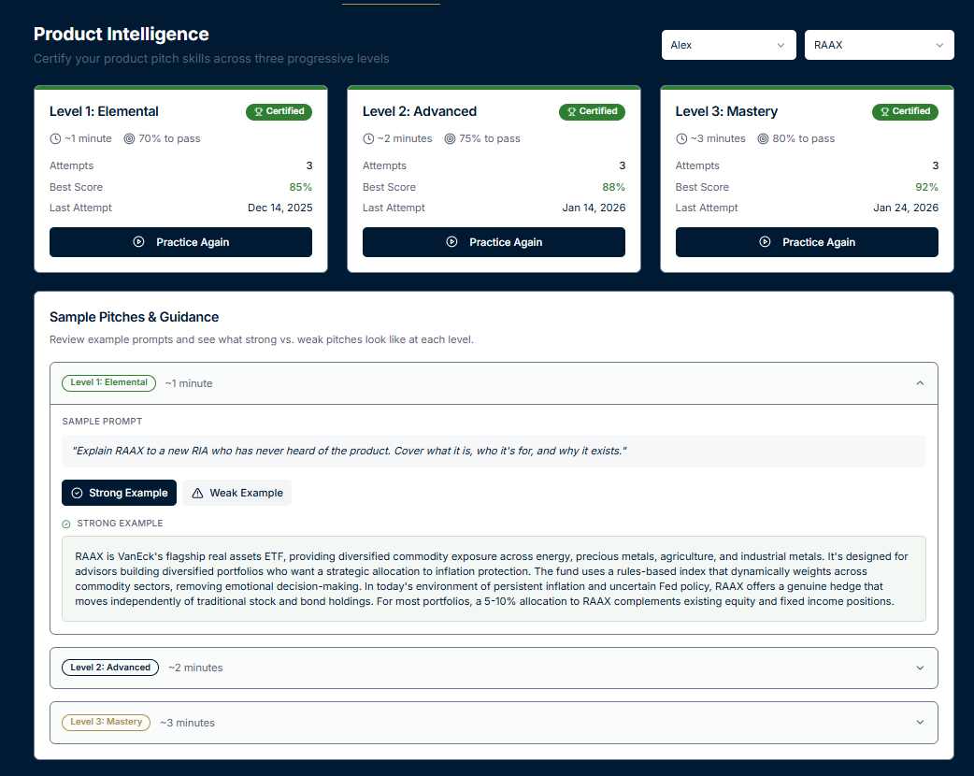



Product Readiness: Progressive, Gated, and Designed to Build Confidence
MASTERY
Scenario judgment
Risk framing
Integrated firm narrative
ADVANCED
RULES
Must pass prior level to unlock next
Unlimited retakes
Randomized questions
Market application
Portfolio role
Alignment with firm themes
ELEMENTAL
What the product is
Who it’s for
Basic market awareness

Slide 23
Product Intelligence: Readiness to Represent the Product
Product knowledge isn’t enough. Judgment, context, and alignment matter.
Product Knowledge
Market & environment awareness
Advisor & client fit
Portfolio role
Risk & expectation setting
Narrative discipline
Firm investment theme alignment
Evaluates
A rep can sell well — and still sell the wrong thing the wrong way.

Slide 24
Product Intelligence: How Readiness is Evaluated
End-to-End Intelligence Flow
Product Intelligence evaluates whether a rep is ready to responsibly represent a product by combining structured assessments with AI-driven analysis.
End-to-End Intelligence Flow
1
2
3
4
5
Input
AI Normalization
Intelligence Evaluation
Scoring & Logging
Coaching & Dashboards
  Product Intelligence assessment initiated
  Product, level (Elemental / Advanced / Mastery), and context selected
  (Future: optional linkage to related sales conversations)
  Questions dynamically selected from product-specific pools
  Question order randomized per attempt
  Difficulty aligned to level and prior performance
  Responses evaluated across Product Intelligence dimensions:
    Product Knowledge
    Market & Environment Awareness
    Advisor & Client Fit
    Portfolio Role
    Risk & Expectation Setting
    Narrative Discipline
    Firm Investment Theme Alignment
  Questions dynamically selected from product-specific pools
  Question order randomized per attempt
  Difficulty aligned to level and prior performance
Rep-level readiness view
Manager visibility into:
    Strengths
    Gaps
    Repeated friction points
  Coaching recommendations generated
*Live Product Intelligence evaluation (in-call or real-time prompts) is roadmap only and not required for v1.*

Slide 25
Optimization: Sales Intelligence
Execution Quality in Real Conversations
Shows how reps sell — and where execution breaks down across advisor interactions
Conversation Structure
Engagement Quality
Outcome Progression
How reps open and frame conversation
Whether discovery happens before positioning
How objections are handled
Shows subject matter fluency
Quality of advisor interaction and flow
Whether conversations move toward clear next steps
Coaching triggers and risk signals
An intelligence layer that evaluates how reps sell and surfaces execution risk — without disrupting workflows or compliance

Slide 26
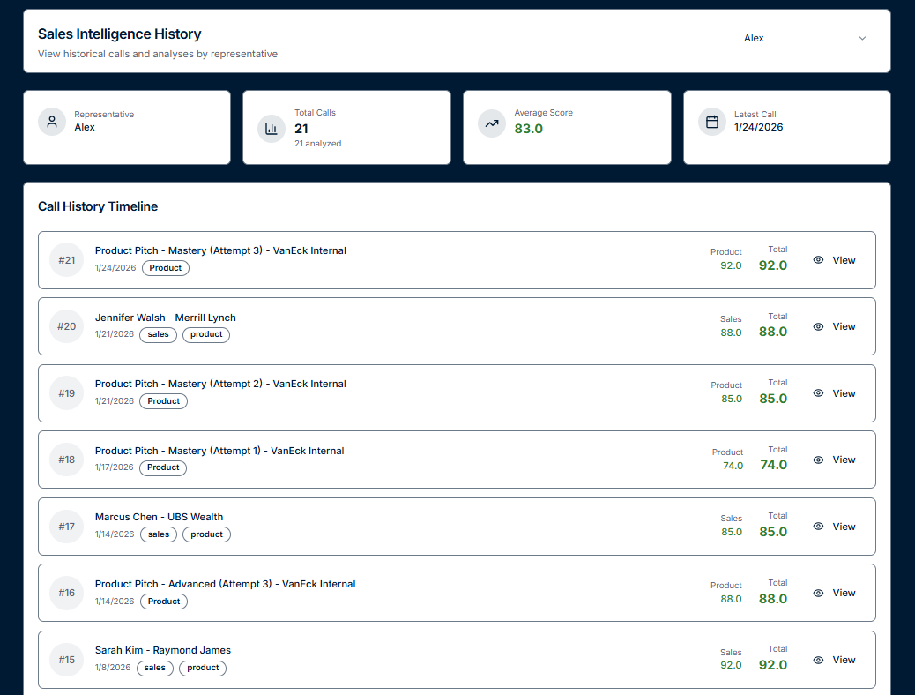
Sales Intelligence: Execution Quality in Real Conversations
Inputs | Evaluates | Outputs
Transcripts | How reps structure and guide conversations | Category-level scores
Audio | Whether they diagnose before positioning | Strengths & gaps
Video (all normalized to transcript for analysis) | How objections are handled | Coaching triggers
 | Whether calls move toward clear next steps | Manager visibility by rep and team

Slide 27
Acceleration: Coaching Insights
Practitioner-led coaching that strengthens advisor engagement
Our Experience and Credibility
Our Coaching
Our Experience and Credibility
Coaching delivered by practitioners with direct experience working
with financial advisors
Applied, scenario-based coaching built around real world
advisor conversations
Reinforces firm messaging through real-world practice and repetition
Ongoing coaching model that drives consistent execution over time
Coaching advisors for 20+ years
Actively coach 150-200 advisors and teams annually
Conduct 100+ advisor events each year
Partnered with leading firms across channels, including wires, independents and RIAs

Slide 28



Timeline
Building a sustainable organic growth engine requires commitment, partnership, and a systematic approach.
Conduct Baseline Competency
Month 2
Coaching Kickoffs
Month 3
Onboarding
Month 1
Team rollout
Deploy assessments for baseline competency
Measure progress and demonstrate ROI
Kick off activation workshops
Coaching cohorts and/or 1:1s
Set the stage for sustained capability building
Define focus products & topics
GrowthStack integration
System testing
Weekly calls with management
Ensure alignment before launch
Week 1: Product Intelligence (asynchronous)
Week 2: Sales Intelligence (asynchronous)
Week 3: AlphaScale-led coaching sessions
Week 4: Leadership dashboard review
Operating Rhythm
Months 4-6

Slide 29

Appendix A: Sample Product Intelligence Questions
Example (RAAX)
What is the primary role of RAAX in a diversified portfolio?
Replace equities
Tactical trading vehicle
Real asset allocation complementing stocks and bonds
Guaranteed inflation hedge
All questions are multiple choice
Randomized per attempt
Correct answers never shown

Slide 30
Appendix B: Sample Sales Intelligence Evaluation
Category Scores
Call Control: 82%
Discovery Depth: 68%
Objection Handling: 74%
Closing Strength: 61%
AI Insight:
Strong discovery early, but weak closing sequence. Coaching recommended on next-step framing.

Slide 31
Appendix C: Sample Product Intelligence Scorecard
Product: RAAX
Dimension
Score
Product Knowledge
Market Awareness
Portfolio Role
Theme Alignment
Risk Framing
90%
72%
70%
65%
78%
Insight:
Product knowledge is strong, but firm-theme alignment needs reinforcement before client-facing use.

Slide 32
Q&A

